Slide 1


BASIC LABARATORY INFORMATION SYSTEM
BLIS
Kenneth Sila Mutuma

Slide 2

Objective
Access Controls; List Users, Searching users, Viewing a users details, Updating and Deleting a user account
Permissions; Listing, Defining and updating
Roles; Listing, Adding, Updating and Deleting
Assigning Roles; Assigning and updating
Password management;
1.Resetting a password
2. Updating a password

Slide 3
Access Controls

Slide 4

User Accounts
This page shows all the users with access to the system. It allows you to create new user accounts, edit account settings and delete accounts

Slide 5
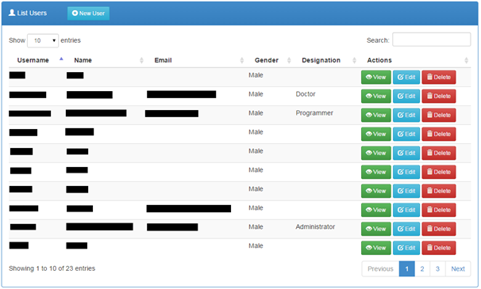
List Users
Click the link on the navigation menu.

Slide 6

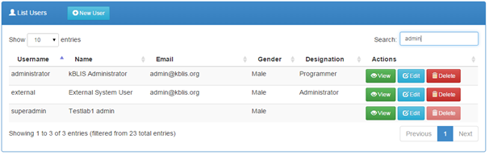


Searching a User
1. Begin typing a user’s name, username or email in the search field
2. The list shall be automatically filtered

Slide 7
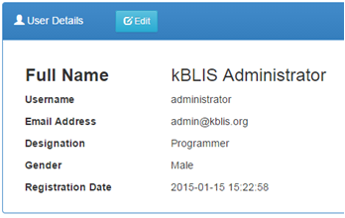
Viewing a User’s Details
1. Click the button to load the measure details
2. The user details shall be loaded on to a panel

Slide 8
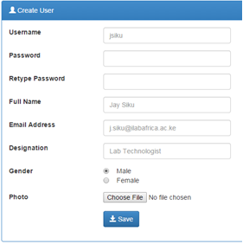
Adding a new User
1. Click the button to load a new user account form
2. Complete the form with the user’s details
3. Click the button to save the changes.

Slide 9
Practical 1 Example
Add a new user with the following information;
Username: Jsmith
Password : JsMith12
Full Name : John Smith
Email : jsmith@gmail.com
Designation : Lab Technologist
Gender : Male

Slide 10

Updating a User’s Details
1. Click the button on the users list.
2. Make the desired modifications to the pre-filled details
3. Click the button to save the changes.

Slide 11
Practical 2
Update John Smith name to Jack John Smith and save

Slide 12

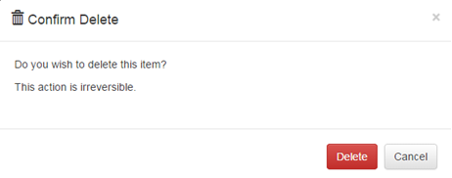


Deleting a User
1. To delete, click the button.
2. Click the button on the pop-up if you are sure to delete, otherwise, click the button or icon to dismiss.

Slide 13
Permissions

Slide 14
This is where each role in the system is assigned specific action enabled for that role

Slide 15
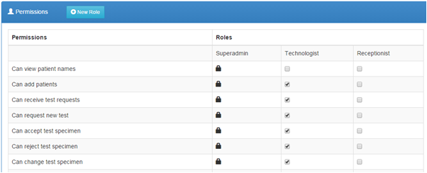

List all Permissions
1. Click the link on the navigation menu.
2. The list of all permissions is as shown

Slide 16
Defining and Updating Privileges
1. Check all permissions a role can be allowed to handle as designed by the lab as shown above.
2. Click the button to save the changes.

Slide 17
Roles

Slide 18
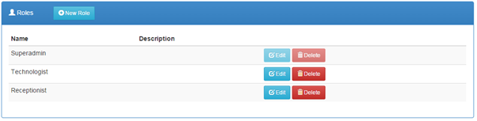
Listing Roles
1. Click the link on the navigation menu
2. The list of available roles shall be loaded

Slide 19
Adding a new Role
1. Click the button
2. Complete the presented form
3. Click the button to save the changes

Slide 20
Updating an Existing Role
1. Click the button
2. Make the necessary modifications to the data
3. Click the button to save the changes.

Slide 21
Practical 3
Create a new role c

Slide 22

Deleting a Role
1. To delete click the button
2. Click the button on the pop-up if you are sure to delete, otherwise, click the button or icon to dismiss.

Slide 23
Assigning Roles

Slide 24
It allows for the assignment of specific roles to the various users of the system.

Slide 25
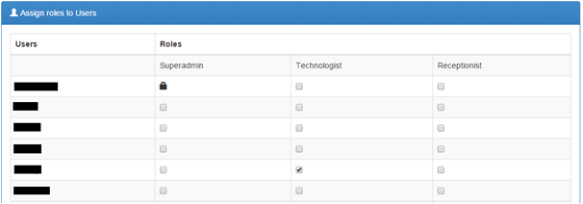
Assigning and Updating Assigned Roles to Users
1. Click the link on the navigation bar.
2. On the loaded panel, check as appropriate to the user and role
3. Click the button to save the changes.

Slide 26
Practical 4
Assign John Smith the Demo role and lab technologist. Click on permissions and click on the necessary privileges. Then switch to jsmith account for verification.

Slide 27
Password Management

Slide 28
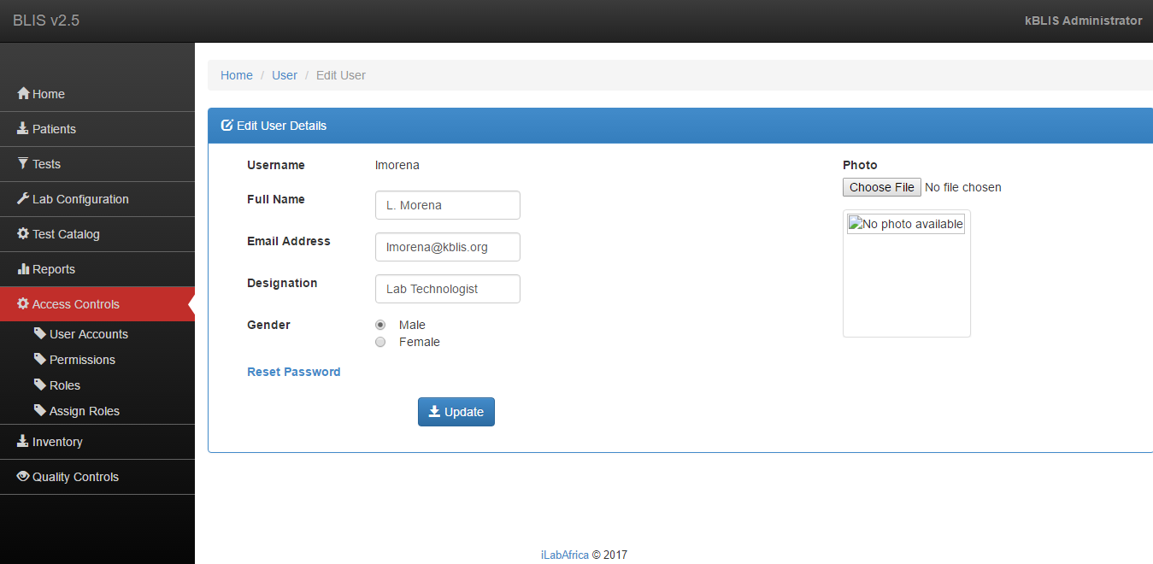


Reset Password
To reset the password click on user accounts link and click . Button. The below window will appear.

Slide 29
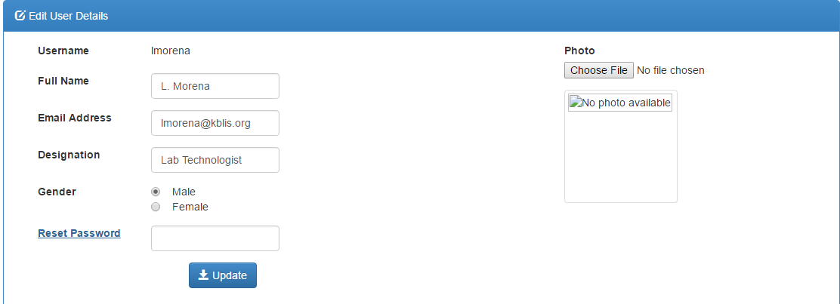

Click on the Reset password highlighted in blue. An input text box will appear as shown below

Slide 30

Click on the button to save the changes

Slide 31
Changing password

Slide 32
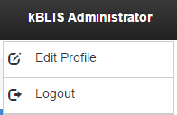

To change the account password, click on the user account on the top right corner e.g kBlis Administrator .
A drop down menu will appear as the on below;

Slide 33

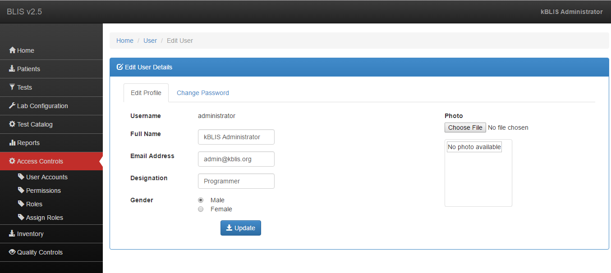

Click on the button. The following window will appear;

Slide 34
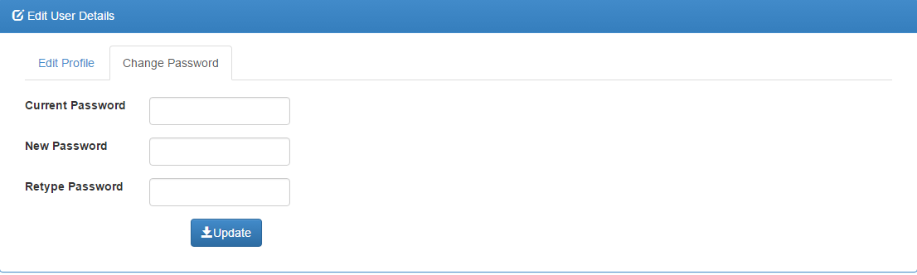

Click on the Change password tab
Enter the current password and the new password. Retype the password and click button.

